Slide 1


Calculus and applications
MTH10012
Week 3

Slide 2
Introduction
Week 2
Elementary functions and their graphs
Limit of a function and limit laws
Week 3
MODULE 2
Limits at infinity and infinite limits
Indefinite forms
The sandwich theorem and standard limits
Continuity
Theorems of continuity and applications to limits

Slide 3
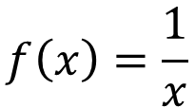
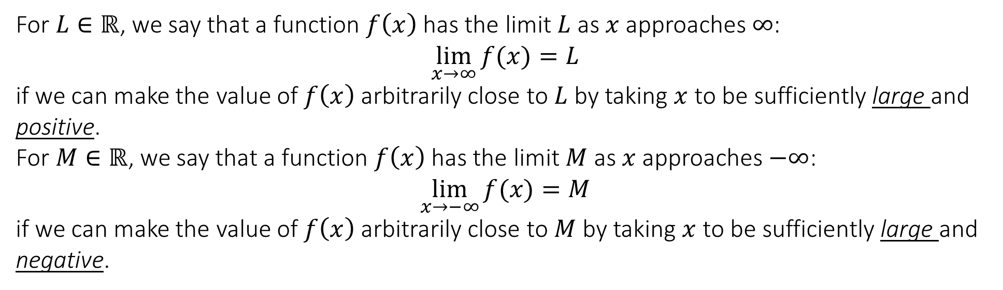

2.3 Limits at infinity and infinite limits
Limit at infinity
For $L∈ℝ$, we say that a function $f\left(x\right)$ has the limit $L$ as $x$ approaches $∞$:
$$\lim_{x→∞}{f(x)}=L$$
if we can make the value of $f\left(x\right)$ arbitrarily close to $L$ by taking $x$ to be sufficiently large and positive.
For $M∈ℝ$, we say that a function $f\left(x\right)$ has the limit $M$ as $x$ approaches $−∞$:
$$\lim_{x→−∞}{f(x)}=M$$
if we can make the value of $f\left(x\right)$ arbitrarily close to $M$ by taking $x$ to be sufficiently large and negative.
$$f\left(x\right)=\frac{1}{x}$$
$$g\left(x\right)=e^{−x}$$

Slide 4
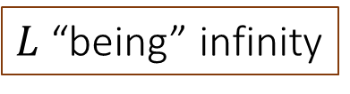
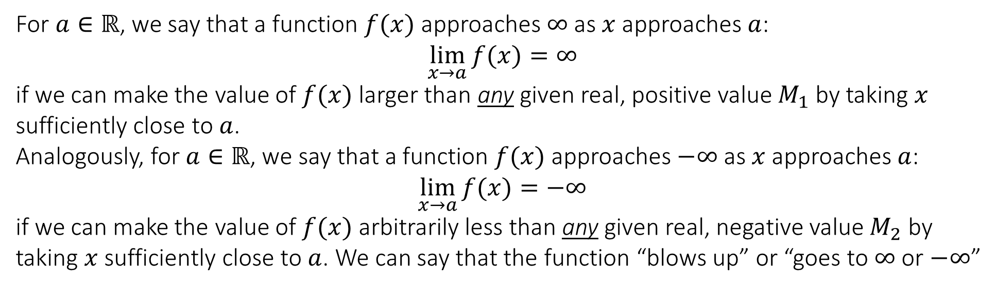
2.3 Limits at infinity and infinite limits
Limit at infinity
All the previously seen limit laws apply to the case of $x$ approaching $±∞$.
$L$ “being” infinity
For $a∈ℝ$, we say that a function $f(x)$ approaches $∞$ as $x$ approaches $a$:
$$\lim_{x→a}{f(x)}=∞$$
if we can make the value of $f(x)$ larger than any given real, positive value $M_{1}$ by taking $x$ sufficiently close to $a$.
Analogously, for $a∈ℝ$, we say that a function $f(x)$ approaches $−∞$ as $x$ approaches $a$:
$$\lim_{x→a}{f(x)}=−∞$$
if we can make the value of $f(x)$ arbitrarily less than any given real, negative value $M_{2}$ by taking $x$ sufficiently close to $a$. We can say that the function “blows up” or “goes to $∞$ or $−∞$”

Slide 5
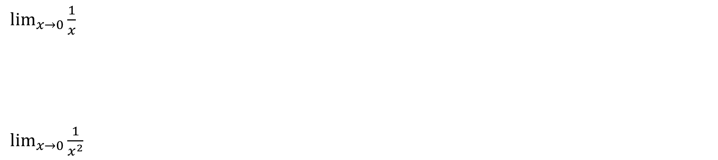
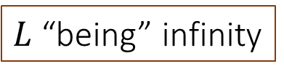
2.3 Limits at infinity and infinite limits
$L$ “being” infinity
$\lim_{x→0}{\frac{1}{x}}$
$\lim_{x→0}{\frac{1}{x^{2}}}$

Slide 6
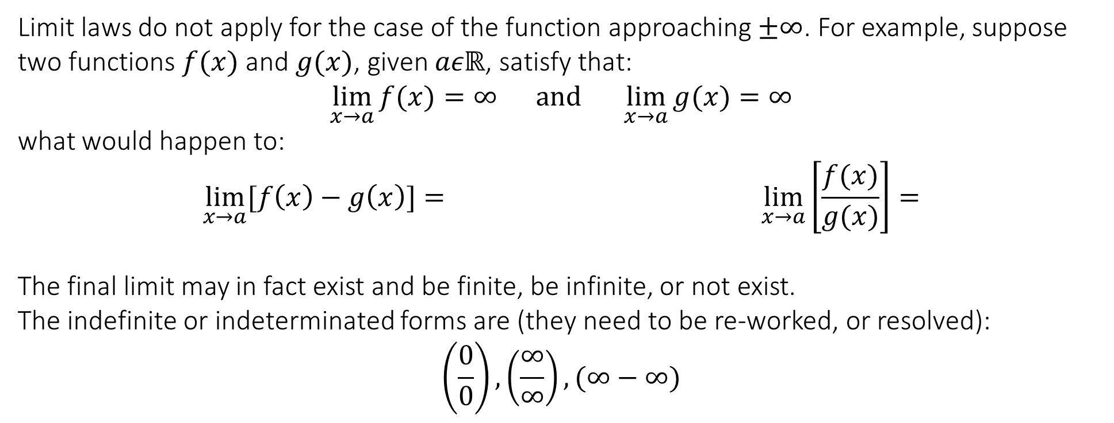
2.3 Limits at infinity and infinite limits
Indefinite forms
Limit laws do not apply for the case of the function approaching $±∞$. For example, suppose two functions $f(x)$ and $g(x)$, given $aεℝ$, satisfy that:
$$\lim_{x→a}{f(x)}=∞ and \lim_{x→a}{g(x)}=∞$$
what would happen to:
$$\lim_{x→a}{[f\left(x\right)−g\left(x\right)]}= \lim_{x→a}\left[\frac{f(x)}{g(x)}\right]=$$
The final limit may in fact exist and be finite, be infinite, or not exist.
The indefinite or indeterminated forms are (they need to be re-worked, or resolved):
$$\left(\frac{0}{0}\right),\left(\frac{∞}{∞}\right), (∞−∞)$$

Slide 7
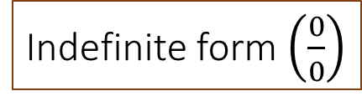
2.4 Indefinite forms
Indefinite form $\left(\frac{0}{0}\right)$
(Factorise or rationalise)
$$\lim_{x→−1}{\frac{x+1}{x^{2}−1}}$$
$$\lim_{x→0}{\frac{\sqrt{1+x}−1}{x}}$$

Slide 8
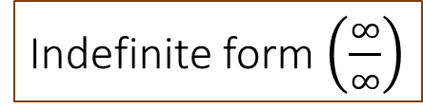
2.4 Indefinite forms
Indefinite form $\left(\frac{∞}{∞}\right)$
(Which one goes faster to infinity?)
$$\lim_{x→∞}{\frac{3x^{2}−1}{x^{2}−3x+1}}$$
$$\lim_{x→∞}{\frac{7x^{3}−4x^{2}+3x−1}{4x^{2}+11x−6}}$$

Slide 9
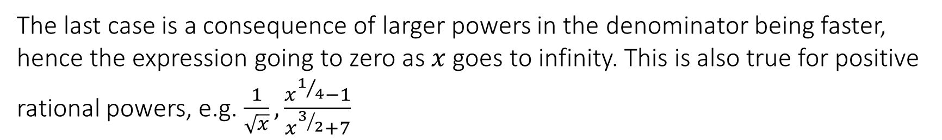
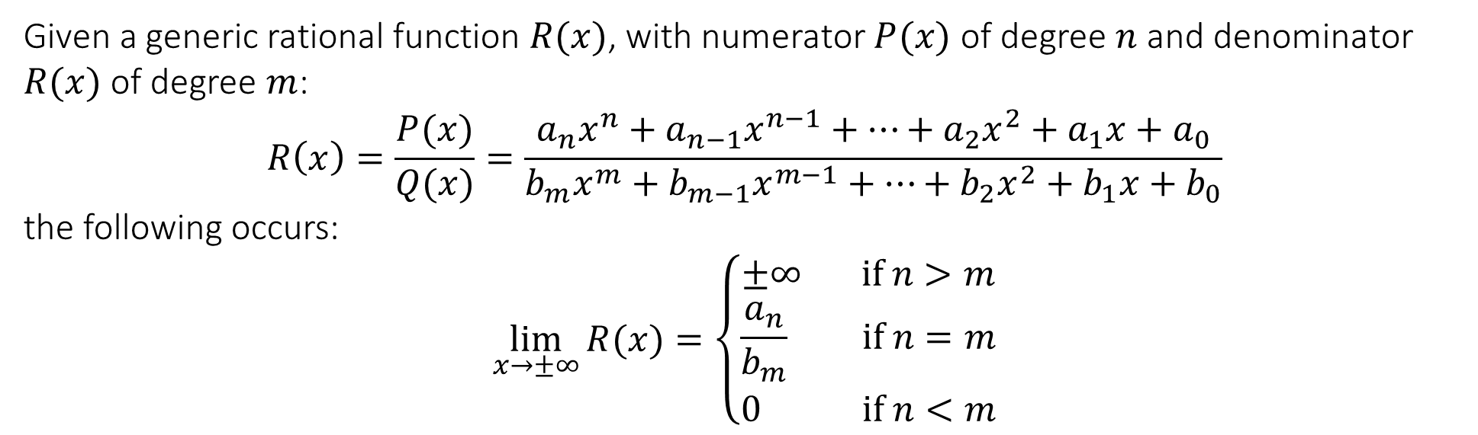
2.4 Indefinite forms
Limits at infinity for rational functions
Given a generic rational function $R(x)$, with numerator $P(x)$ of degree $n$ and denominator $R(x)$ of degree $m$:
$$R\left(x\right)=\frac{P(x)}{Q(x)}=\frac{a_{n}x^{n}+a_{n−1}x^{n−1}+…+a_{2}x^{2}+a_{1}x+a_{0}}{b_{m}x^{m}+b_{m−1}x^{m−1}+…+b_{2}x^{2}+b_{1}x+b_{0}}$$
the following occurs:
$$\lim_{x→±∞}{R(x)}=\left\{\begin{matrix}±∞ if n>m \\ \frac{a_{n}}{b_{m}} if n=m \\ 0 if n<m\end{matrix}\right.$$
The last case is a consequence of larger powers in the denominator being faster, hence the expression going to zero as $x$ goes to infinity. This is also true for positive rational powers, e.g. $\frac{1}{\sqrt{x}}, \frac{x^{1/4}−1}{x^{3/2}+7}$

Slide 10
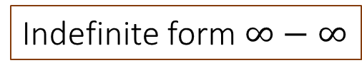
2.4 Indefinite forms
Indefinite form $∞−∞$
(Rationalise)
$$\lim_{x→∞}{\sqrt{4x^{2}+4x+3}−2x−1}$$

Slide 11

2.5 The sandwich theorem and standard limits
(Sandwich theorem). Given $a,Lεℝ$ and three functions $f\left(x\right),g\left(x\right),h(x)$, if we have that
$$g\left(x\right)≤f\left(x\right)≤h(x)$$
when $x$ is near $a$ (but not necessarily for $x=a$) and
$$\lim_{x→a}{g(x)}=\lim_{x→a}{h(x)}=L$$
then
$$\lim_{x→a}{f(x)}=L$$

Slide 12
2.5 The sandwich theorem and standard limits
$$\lim_{x→0}{x^{2}sin⁡\left(\frac{1}{x}\right)}$$
$$\lim_{x→∞}{\frac{\arctan\left(x^{3}\right)}{x^{2}}}$$

Slide 13
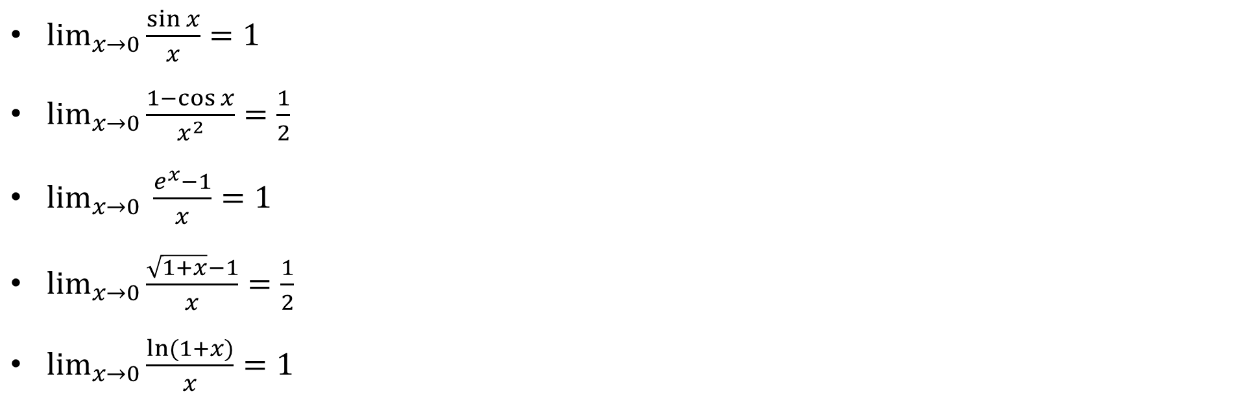
2.5 The sandwich theorem and standard limits
Standard limits using the sandwich theorem
$\lim_{x→0}{\frac{\sin{x}}{x}}=1$
$\lim_{x→0}{\frac{1−\cos{x}}{x^{2}}=\frac{1}{2}}$
$\lim_{x→0}{\frac{e^{x}−1}{x}=1}$
$\lim_{x→0}{\frac{\sqrt{1+x}−1}{x}=\frac{1}{2}}$
$\lim_{x→0}{\frac{ln⁡(1+x)}{x}=1}$

Slide 14

2.5 The sandwich theorem and standard limits
Standard limits using the sandwich theorem
$\lim_{x→0}{\frac{\sin{x}}{x}}=1$
D
C
$$x$$
A
E
B

Slide 15
2.5 The sandwich theorem and standard limits
Standard limits using the sandwich theorem
$\lim_{x→0}{\frac{1−\cos{x}}{x^{2}}}=\frac{1}{2}$

Slide 16
2.5 The sandwich theorem and standard limits
Standard limits using the sandwich theorem
$\lim_{x→0}{\frac{e^{x}−1}{x}}=1$

Slide 17
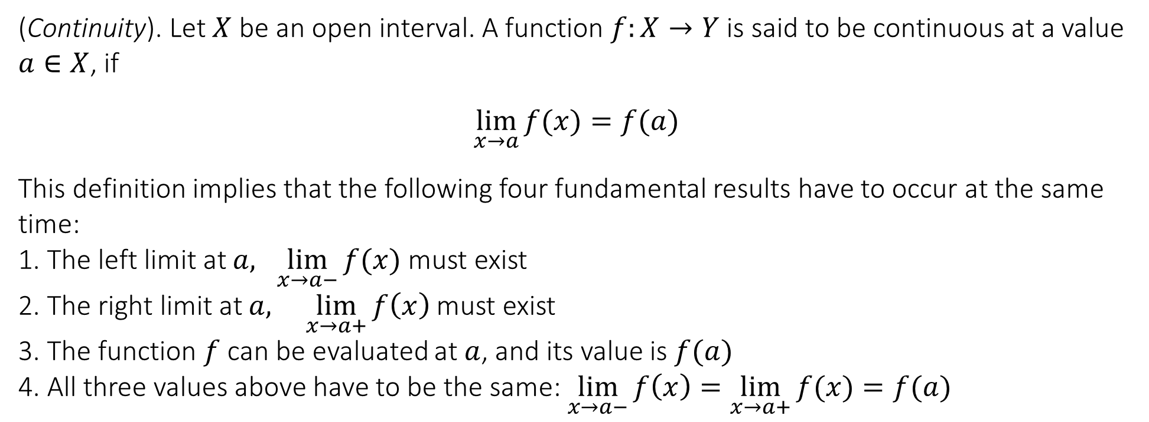
2.6 Continuity
(Continuity). Let $X$ be an open interval. A function $f:X→Y$ is said to be continuous at a value $a∈X$, if
$$\lim_{x→a}{f(x)}=f(a)$$
This definition implies that the following four fundamental results have to occur at the same time:
1. The left limit at $a, \lim_{x→a−}{f(x)}$ must exist
2. The right limit at $a, \lim_{x→a+}{f\left(x\right)}$ must exist
3. The function $f$ can be evaluated at $a$, and its value is $f(a)$
4. All three values above have to be the same: $\lim_{x→a−}{f\left(x\right)=\lim_{x→a+}{f(x)}=f(a)}$
Continuity is defined as a “local” property of a function. This means that the definition establishes if a function $f(x)$ is continuous at a given value $a$.

Slide 18

Test your knowledge
1. Determine if the following functions are continuous at the given points.
a) $f\left(x\right)=\sqrt{x}, x=0$
b)The sign function, $x=0$
c) $f\left(x\right)=\left\{\begin{matrix}2x+1 if x<0 \\ 0 if x=0 \\ x^{2}+1 if x>0\end{matrix}\right., x=0$
d) $f\left(x\right)=\frac{x^{2}−x−2}{x−2}, x=2$
NO
NO
NO
NO

Slide 19
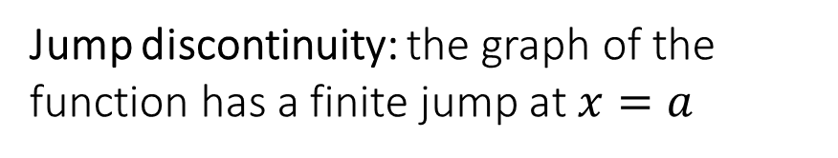
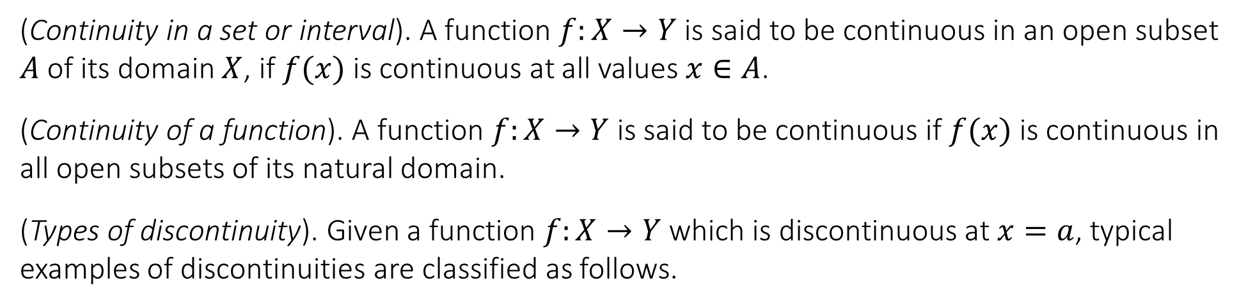
2.6 Continuity
(Continuity in a set or interval). A function $f:X→Y$ is said to be continuous in an open subset $A$ of its domain $X$, if $f(x)$ is continuous at all values $x∈A$.
(Continuity of a function). A function $f:X→Y$ is said to be continuous if $f(x)$ is continuous in all open subsets of its natural domain.
(Types of discontinuity). Given a function $f:X→Y$ which is discontinuous at $x=a$, typical examples of discontinuities are classified as follows.
Jump discontinuity: the graph of the function has a finite jump at $x=a$

Slide 20
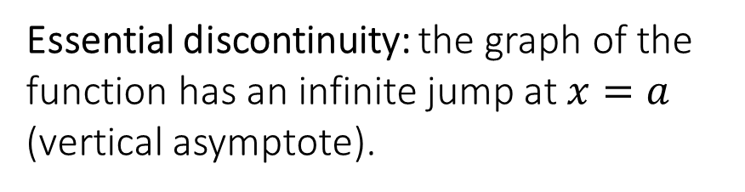
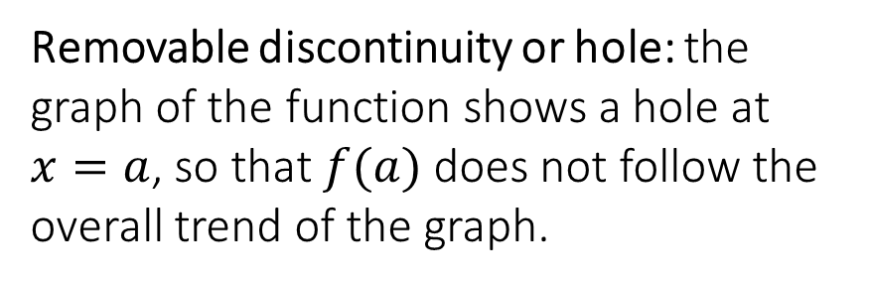
2.6 Continuity
Essential discontinuity: the graph of the function has an infinite jump at $x=a$ (vertical asymptote).
Removable discontinuity or hole: the graph of the function shows a hole at $x=a$, so that $f(a)$ does not follow the overall trend of the graph.

Slide 21
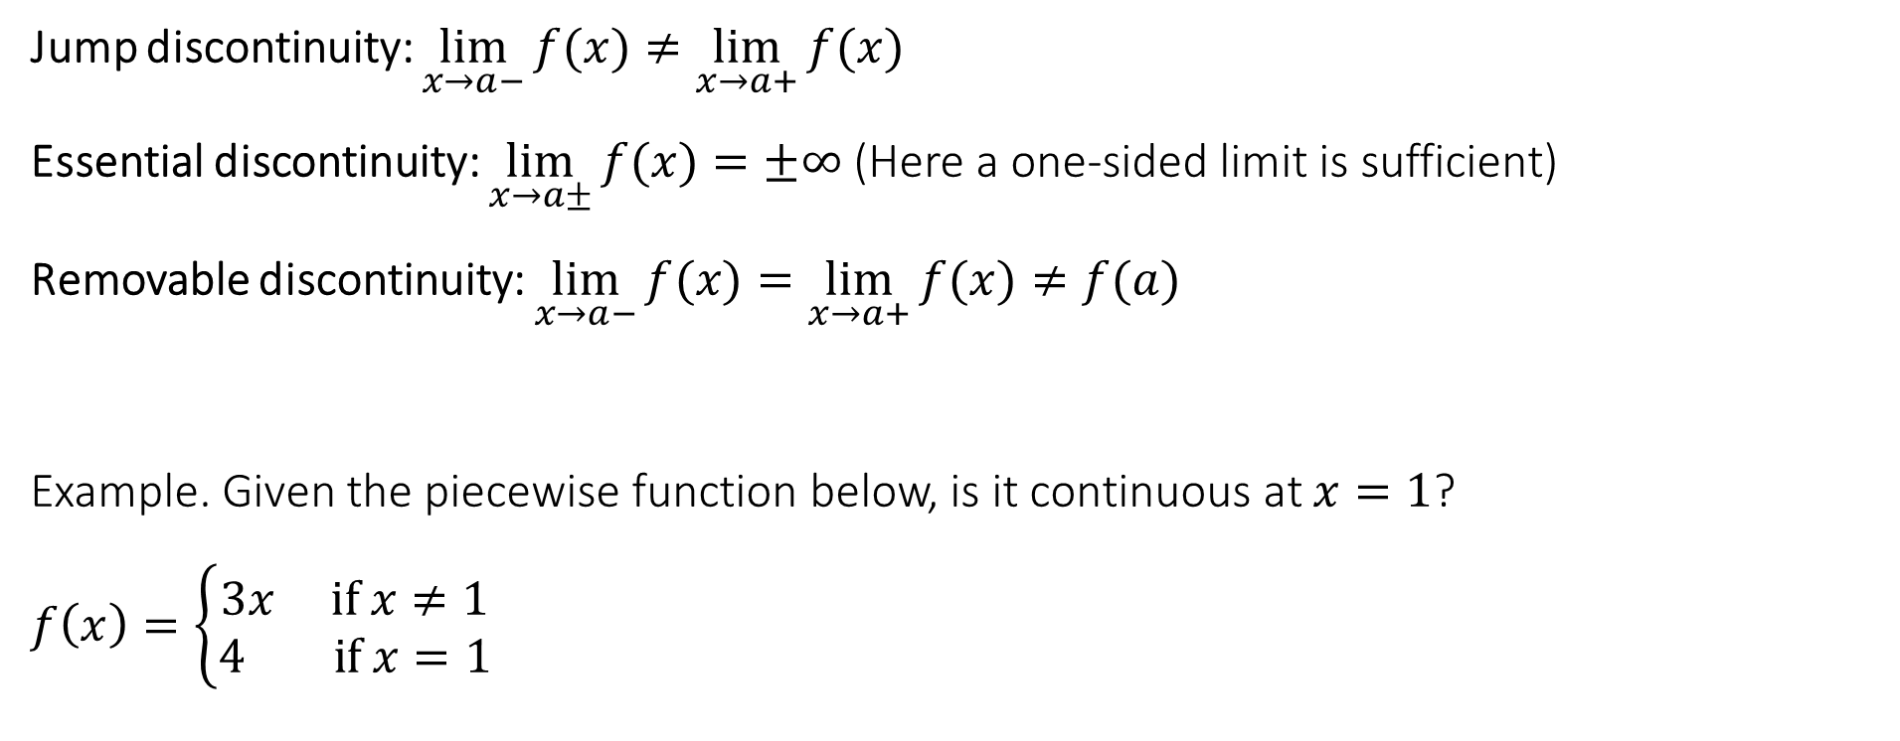
2.6 Continuity
Jump discontinuity: $\lim_{x→a−}{f(x)}≠\lim_{x→a+}{f(x)}$
Essential discontinuity: $\lim_{x→a±}{f(x)}=±∞$ (Here a one-sided limit is sufficient)
Removable discontinuity: $\lim_{x→a−}{f(x)}=\lim_{x→a+}{f(x)}≠f(a)$
Example. Given the piecewise function below, is it continuous at $x=1$?
$$f\left(x\right)=\left\{\begin{matrix}3x if x≠1 \\ 4 if x=1\end{matrix}\right.$$

Slide 22
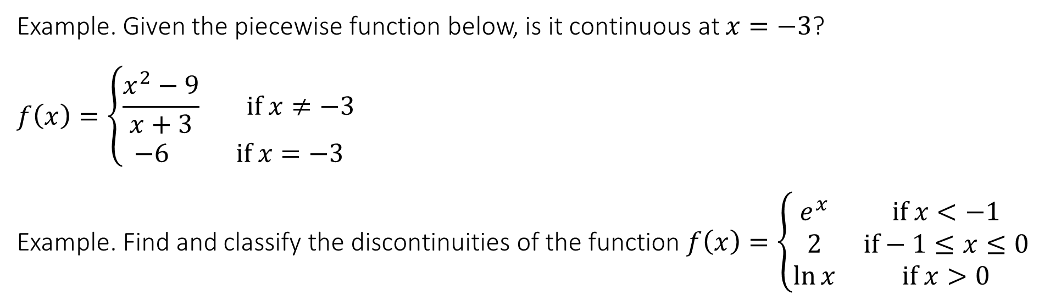
2.6 Continuity
Example. Given the piecewise function below, is it continuous at $x=−3$?
$$f\left(x\right)=\left\{\begin{matrix}\frac{x^{2}−9}{x+3} if x≠−3 \\ −6 if x=−3\end{matrix}\right.$$
Example. Find and classify the discontinuities of the function $f\left(x\right)=\left\{\begin{matrix}e^{x} & if x<−1 \\ 2 & if−1≤x≤0 \\ \ln{x} & if x>0\end{matrix}\right.$

Slide 23
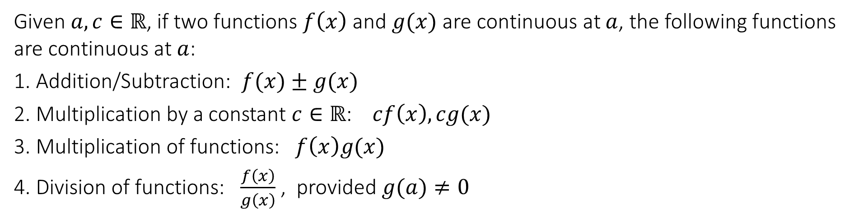
2.7 Theorems on continuity and applications to limits
Linearity, multiplication and division
Given $a,c∈ℝ$, if two functions $f\left(x\right)$ and $g(x)$ are continuous at $a$, the following functions are continuous at $a$:
1. Addition/Subtraction: $f(x)±g(x)$
2. Multiplication by a constant $c∈ℝ$: $cf\left(x\right),cg(x)$
3. Multiplication of functions: $f\left(x\right)g(x)$
4. Division of functions: $\frac{f\left(x\right)}{g\left(x\right)}$ , provided $g(a)≠0$
Composition
Given $a∈ℝ$, if $f\left(x\right)$ is continuous at $a$and $g(x)$ is continuous at $f(a)$, then the composition $g(f\left(x\right))$ is continuous at $x=a$.

Slide 24
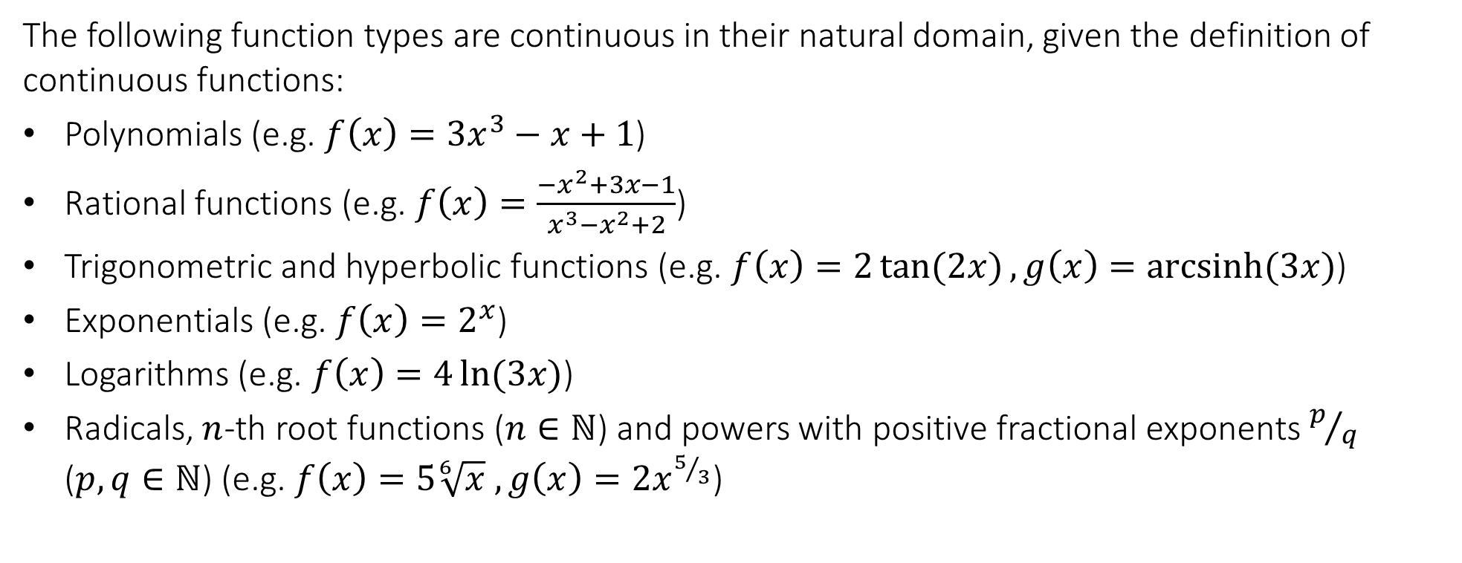
2.7 Theorems on continuity and applications to limits
Standard continuous functions
The following function types are continuous in their natural domain, given the definition of continuous functions:
Polynomials (e.g. $f\left(x\right)=3x^{3}−x+1$)
Rational functions (e.g. $f\left(x\right)=\frac{−x^{2}+3x−1}{x^{3}−x^{2}+2}$)
Trigonometric and hyperbolic functions (e.g. $f\left(x\right)=2\tan{(2x)}, g\left(x\right)=\operatorname{arcsinh}{(3x)}$)
Exponentials (e.g. $f\left(x\right)=2^{x}$)
Logarithms (e.g. $f\left(x\right)=4\ln{(3x)}$)
Radicals, $n$-th root functions ($n∈ℕ$) and powers with positive fractional exponents $p/q$ ($p,q∈ℕ$) (e.g. $f\left(x\right)=5\sqrt[6]{x} , g\left(x\right)=2x^{5/3}$)

Slide 25
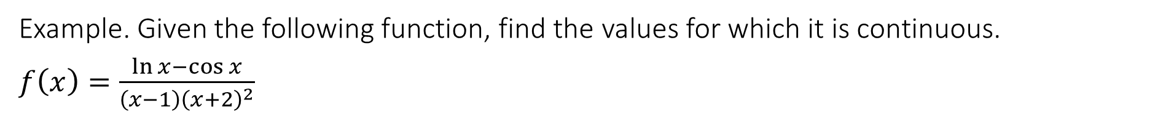
2.7 Theorems on continuity and applications to limits
Example. Given the following function, find the values for which it is continuous.
$f\left(x\right)=\frac{\ln{x}−\cos{x}}{\left(x−1\right){\left(x+2\right)}^{2}}$

Slide 26
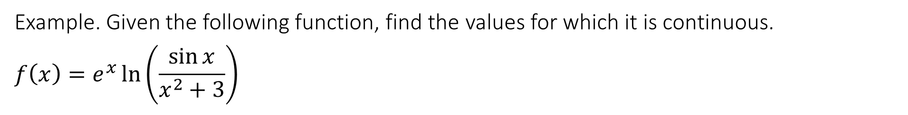
2.7 Theorems on continuity and applications to limits
Example. Given the following function, find the values for which it is continuous.
$$f\left(x\right)=e^{x}\ln\left(\frac{\sin{x}}{x^{2}+3}\right)$$

Slide 27
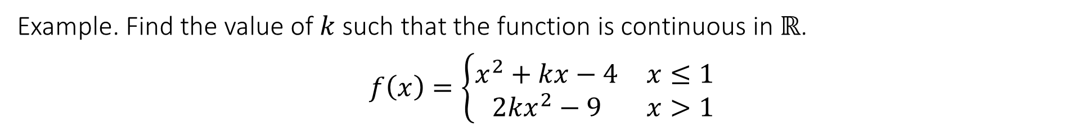
2.7 Theorems on continuity and applications to limits
Example. Find the value of $k$ such that the function is continuous in $ℝ$.
$$f\left(x\right)=\left\{\begin{matrix}x^{2}+kx−4 & x≤1 \\ 2kx^{2}−9 & x>1\end{matrix}\right.$$

Slide 28

2.7 Theorems on continuity and applications to limits
Applications to limits
(Theorem). Given $a,bεℝ$, if the following occurs:
1. $f(x)$ is continuous at $b$ and
2. $\lim_{x→a}{g\left(x\right)=b}$
then:
$$\lim_{x→a}{f\left(g\left(x\right)\right)=f(\lim_{x→a}{g(x))}=f(b)}$$
Examples:
1. Evaluate: $\lim_{x→0}{e^{(3−x^{2}+x^{3})}}$
2. Evaluate: $\lim_{x→0+}{\arctan{(\sqrt{x}+1)}}$

Slide 29
End of Lecture

